Slide 1
K-12 STATE LEGISLATION AFFECTING YOUR PUBLIC SCHOOLS
Indiana Coalition for Public Education
Annual Membership Meeting
August 24, 2019

Slide 2
State Supt. of Public Instruction
HB 1005 – Rep. Brian Bosma (R)
Moves up the date to 1-11-2021 when Governor can appoint a Secretary of Education.
Eliminates the publicly elected office of Superintendent of Public Instruction (an office that has been elected since 1852).
Does NOT require any K-12 education experience to be appointed.
Has passed both House & Senate
Signed by Governor Holcomb 4/4/19.

Slide 3
SCHOOL BUS SAFETY
SB 2 – Sen. Head
* Increases penalty from Class A Infraction to Class C Misdemeanor for failing to stop for school bus stop arm & driver’s license suspension of 90 days up to 1 year if prior.
* Increases to A misdemeanor if prior
* Increases to Level 6 Felony if injury
* Increases to Level 5 Felony if death
* Requires schools to review bus routes & bus policies to improve safety
* Prohibits load/unload of students that require student to cross a highway

Slide 4
SCHOOL SAFETY BILLS
HB 1004 – Rep. McNamara
School Safety Grants
Available to all public, charter & accredited non-public schools
Requires Active Shooter Drills
Provides opportunity to participate in CDC Prevention Youth Risk Behavior Survey but only with parental consent
Schools may enter MOU with mental health service providers to provide services to students

Slide 5
Civics Test Requirement
SB 132 – Sen. Dennis Kruse (R)
Provides that as part of the United States government credit awarded for the general, Core 40, Core 40 with academic honors, and Core 40 with technical honors designation, each high school shall administer the naturalization examination provided by the United States Citizenship and Immigration Services. Requires an enhanced study of the Holocaust in each high school United States history course.
Originally required students to take & pass same Civics Test required for immigrants to become US Citizens for HS graduation
After amendments, requires Citizenship Civics Test to be included within the high school Civics/US Government class curriculum.

Slide 6
Education Deregulation
HB 1400 – Rep. T. Cook (R)
Originally would have placed a sunset numerous laws/regulations for K-12 education
After amendments, requires summer study committees to study deregulation/sunsetting of various K-12 laws/regulations over next 5 years.
ICPE authored an amendment to remove from the study elimination of certain curriculum requirements for civics education
ICPE’s amendment passed and is included within the final version of the bill that became law.
This is the FIRST piece of legislation to become law authored in part by ICPE!

Slide 7
Voucher School Expansion
HB 1629 Various Education Matters – Rep. R. Behning (R)
Changes the definition of an elementary school to include those schools that only offer Kindergarten and Pre-K programs.
Impact is that hundreds of current private Pre-K programs already offer a Kindergarten class as well, thereby making them eligible to receive school vouchers.
Could include even proprietary schools if they become accredited.
ICPE lobbied for an amendment to take out change in definition of elementary school but amendment was not offered.

Slide 8
Teacher Pay
HB 1003 – School Corporation Expenditure Targets
Authored by Rep. D. DeVon (R)
Gov’s plan to increase teacher pay.
Provides a school must specify in its budget if it will transfer more than 15% from its education fund to its operations fund.
If so, IDOE must notify the state Office of Management & Budget (OMB) starting in 2020
Also requires school district to explain its reasons for exceeding 15% expenditures on operations to IDOE & Fiscal & Qualitative Indicators Committee at a public meeting.
Does NOT require any increase teacher pay.
School safety, school bus safety, utilities, insurance
custodians & central office administration all part
of the operations fund.

Slide 9
School Finance
HB 1001 – Budget Bill
Authored by Rep. T. Huston (R)
Increases overall state spending on K-12 education by 2.5% each year.
Fails to keep up with inflation rate
Increases the Tax Credit Scholarship Cap from $14M to $15M in FY2019, then to $16M in FY 2020.
Does NOT include the automatic escalator of 120% annually for SGOs.
Increases the teacher classroom supply tax credit from $100 - $500.
Creates a new 70% voucher for more middle income families
House adds $47M to Charter Schools Grant
Total of $70M new money for CHOICE programs
$0 for teacher pay

Slide 10
School Finance
Even though the budget bill increases overall state spending on K-12 education by 2.5% each year….
“About one in five public school districts will see their base state funding cut in one, or both, of the next two years. Most are rural districts with declining enrollment.”
School Matters

Slide 11
School Finance
HB 1021 – Education Finance
Authored by Rep. J. Thompson (R)
Attempts to wean school corps off circuit breaker credits
The bill extends (through 2023) the ability in current law for a school corporation to allocate tax cap credits proportionately (without taking protected taxes into account) under certain circumstances. It provides that a school corporation is eligible to allocate credits proportionately if the school corporation's percentage amount of credits granted against the school corporation's operations fund levy is at least a certain percentage.
Debt service levies for some school corporations could increase in CY 2021 through CY 2024, to replenish operating balances if it becomes necessary to use those balances to make debt payments in CY 2020 through CY 2023.
If debt service levies rise, then all taxing units that intersect the school corporation could be subject to higher tax cap losses.
The increase in debt levies under this provision depends on actions taken by qualifying school corporations.

Slide 12
What may come up in 2020
Not a budget year, short session
Accountability measures, including post secondary
ILEARN
Expanding counselor responsibilities for career counseling
Diploma pathways
Complexity index
More accountability for virtual charter schools
A cap or “pause” for new charter schools
More transparency for voucher/charter funding & management
School safety/weapons
Teacher pay/teacher shortages
Education Savings Accounts

Slide 13
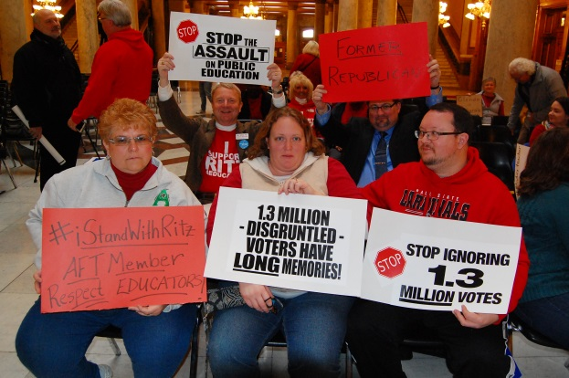
How you can help support public education?
Join ICPE in support of public education in the Statehouse
www.icpe2011.com

Slide 14
Questions?
CONTACT INFORMATION:
Joel D. Hand – jhand@handponist.com
317-608-6621

